Slide 1
Model evaluation
Introduction to SDMs: theory and practice in R
Sapienza University, Rome 9-11 June, 2021
Jamie M. Kass Postdoctoral Scholar
Okinawa Institute of Science and Technology Graduate University (OIST)

Slide 2
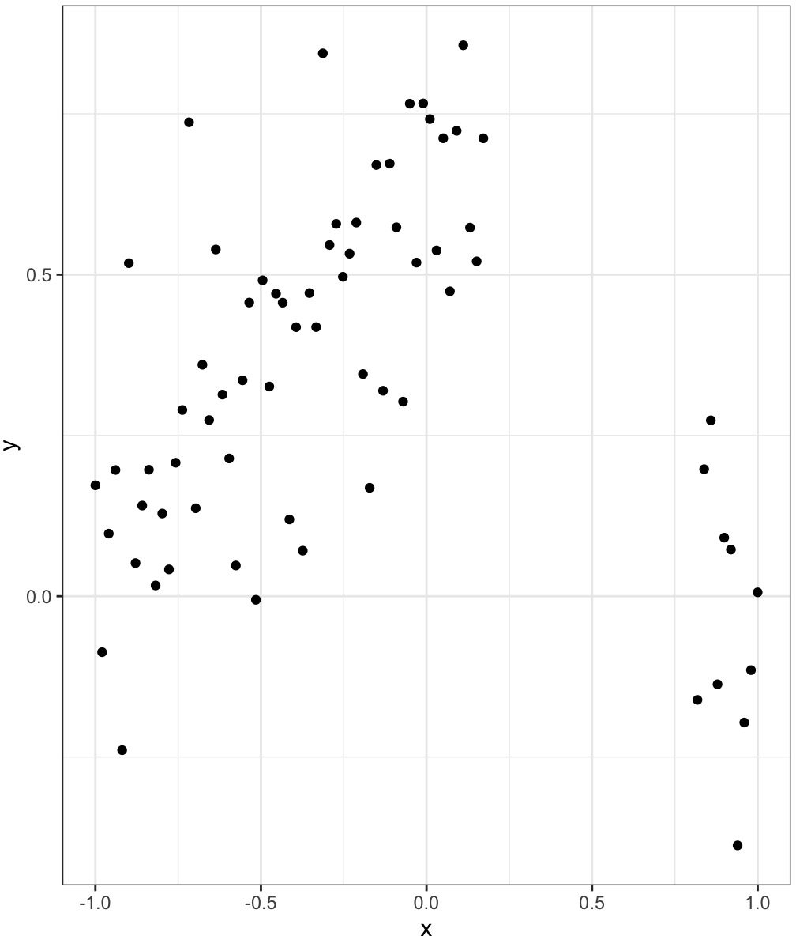
Model complexity
data is messy in varying degrees

Slide 3
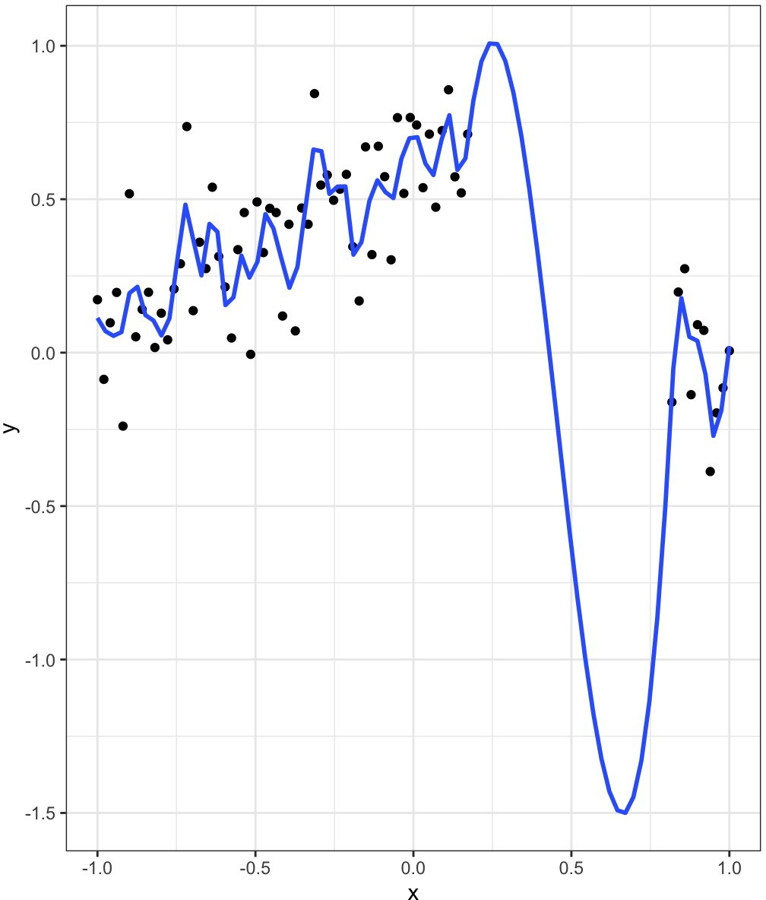
Model complexity
data is messy in varying degrees
models that are too complex can overpredict data

Slide 4
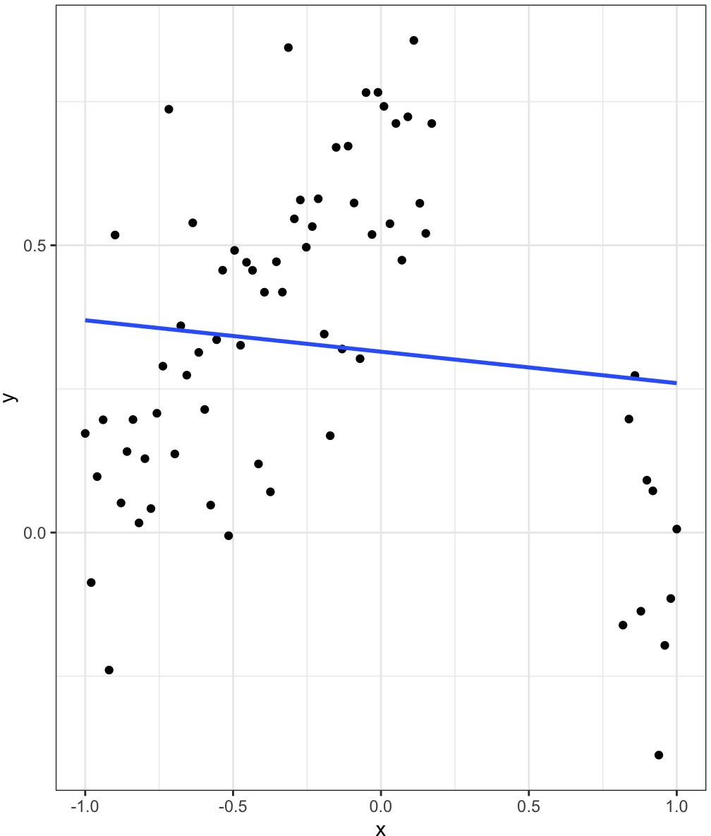
Model complexity
data is messy in varying degrees
models that are too complex can overpredict data
models that are too simple can underpredict data

Slide 5
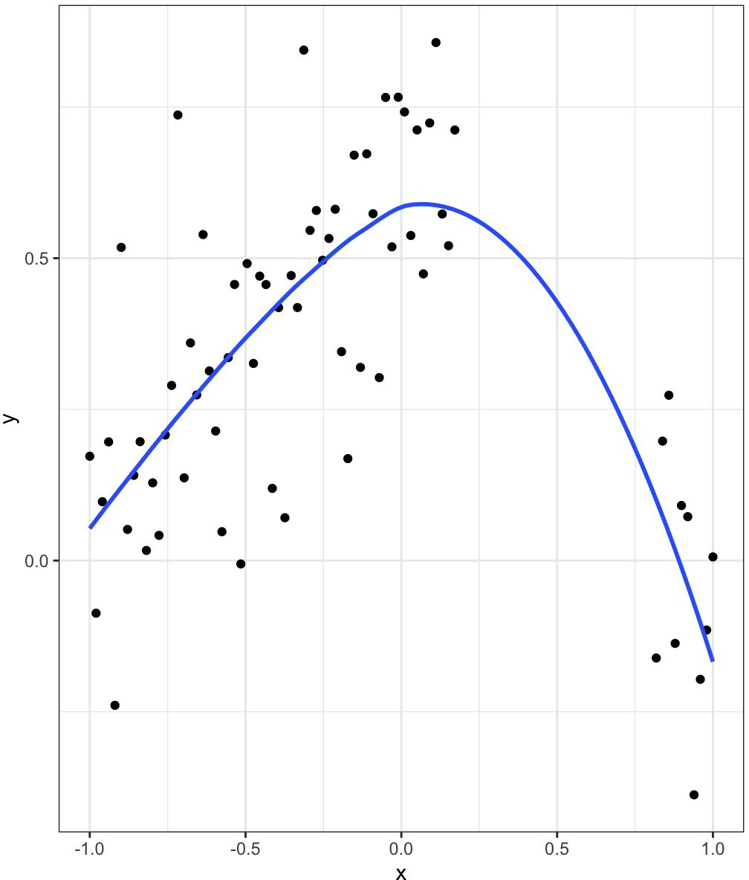
Model complexity
data is messy in varying degrees
models that are too complex can overpredict data
models that are too simple can underpredict data
we need a model in-between

Slide 6
What creates model complexity?
the number of predictor variables used to fit the model
the shapes of the modeled responses
the presence of variable interactions
r = a + b1 * b2

Slide 7
How do we tell how well the model fits?
model evaluation: measures of model performance on different data sets
many metrics exist, and it can get confusing
interpreting the results of model evaluation is also not straightforward
key questions: is the model overfit (too complex) or underfit (too simple)?

Slide 8
How do we control complexity?
exhaustive model selection for standard regression models
machine learning algorithms have tuning parameters to penalize complexity
Examples are Maxent, random forest, boosted regression trees, neural networks, lasso regression

Slide 9
What does a model evaluation tell us?
model performance on the data used to build the model
model performance on new data
ecological realism for:
relationships with predictor variables
spatial predictions

Slide 10
Popular SDM evaluation metrics
metric | threshold | range | high or low? | CV | caveats | R packages
AUC | independent | 0 – 1 | + | yes | cannot use to compare diff spp or extents | dismo, ENMeval, SDMtune, ROCR
pROC | independent | AUC ratio | + | yes | user-set acceptable level of omission error (e = 100% for AUC) | pROC, kuenm, ntbox
Continuous Boyce Index | independent | -1 – 1 | + | yes |  | ecospat, ENMeval
omission rate | dependent | 0 – 1 | - | yes |  | dismo, ENMeval
TSS | dependent | -1 – 1 | + | yes | cannot use to compare diff spp or extents | SDMtune
kappa | dependent | -1 – 1 | + | yes | cannot use to compare diff spp or extents | dismo
AICc | independent | relative | - | no | cannot evaluate transferability | ENMeval, SDMtune

Slide 11
Model evaluation strategy
each model should be able to accurately predict the input data
but can each model also accurately predict new data?
if we have independent data, we can evaluate each model on it
if not, we can evaluate each model on subsets of itself

Slide 12
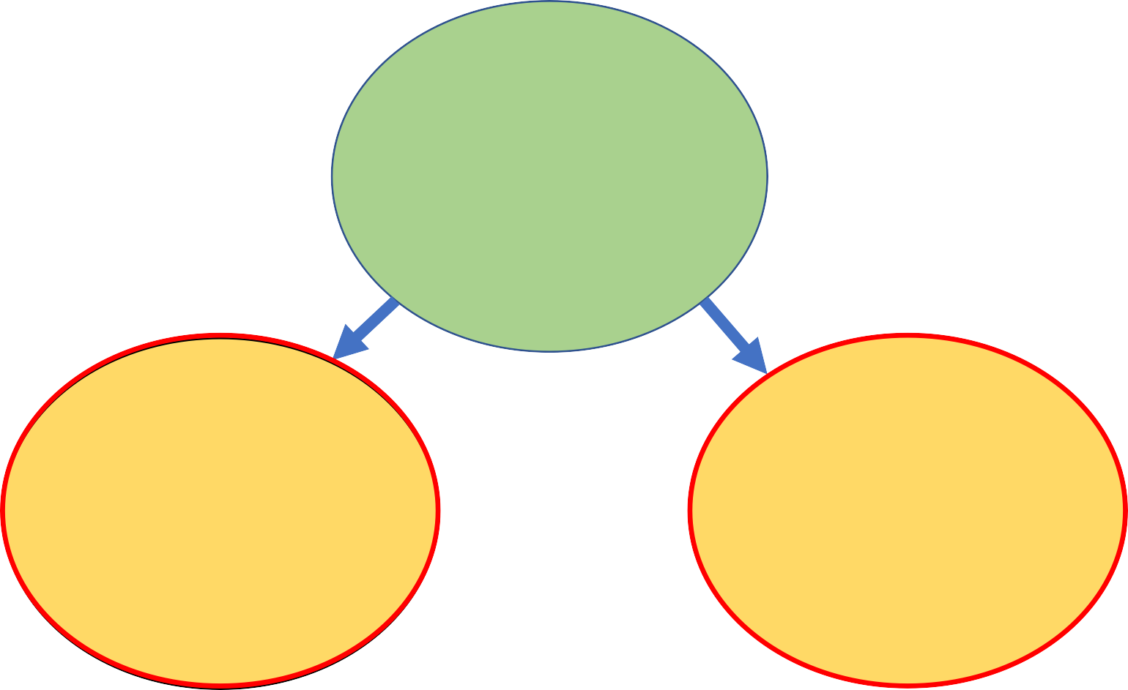
Data for modeling: terminology
FULL DATASET
TRAINING DATA
VALIDATION DATA
INDEPENDENT DATA
cross-validation used to fit the model
used to evaluate the model

Slide 13
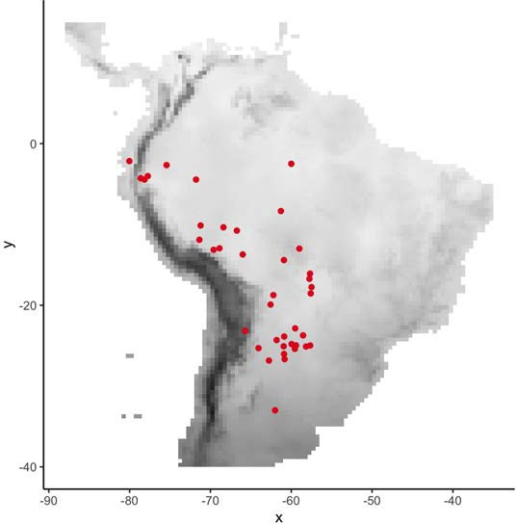
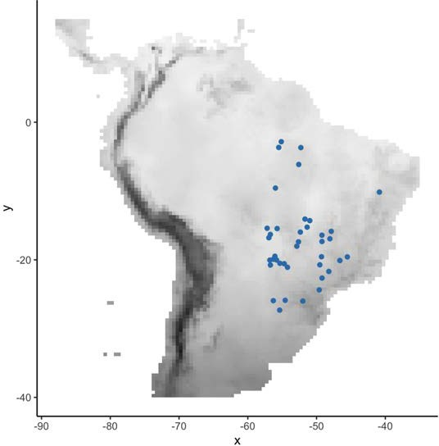
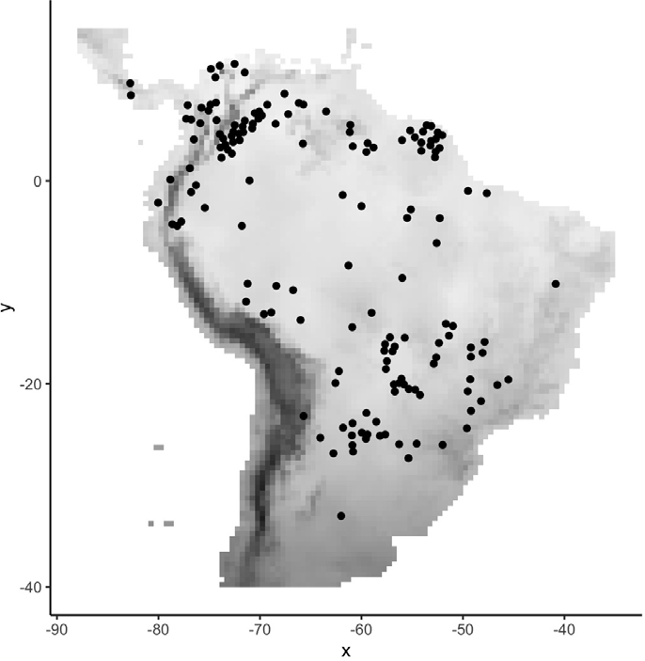
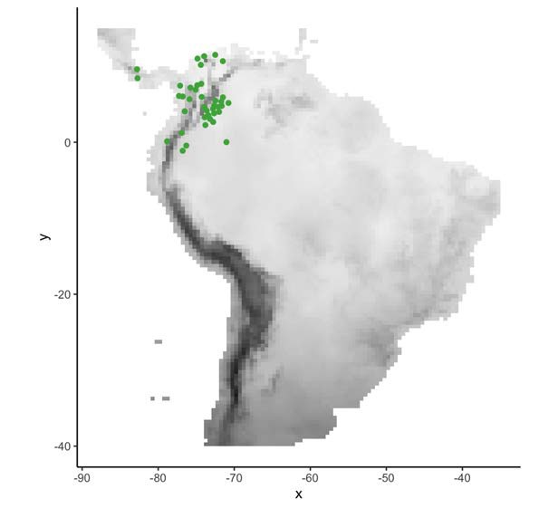
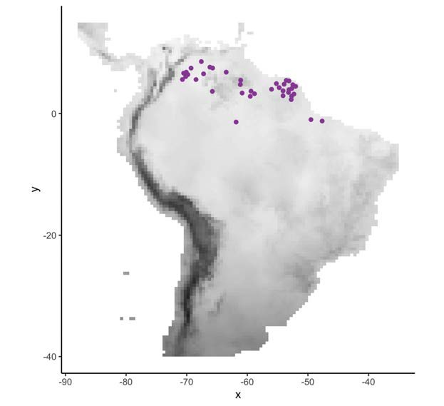
Cross validation
1. Split the data into k groups (a.k.a. subsets, partitions)

Slide 14
Cross validation
2. Train the model on k - 1 subsets

Slide 15
Cross validation
3. Evaluate the model on subset k (calculate an evaluation statistic)

Slide 16
Cross validation
4. Repeat for all k

Slide 17
Cross validation
4. Repeat for all k

Slide 18
Cross validation
4. Repeat for all k

Slide 19
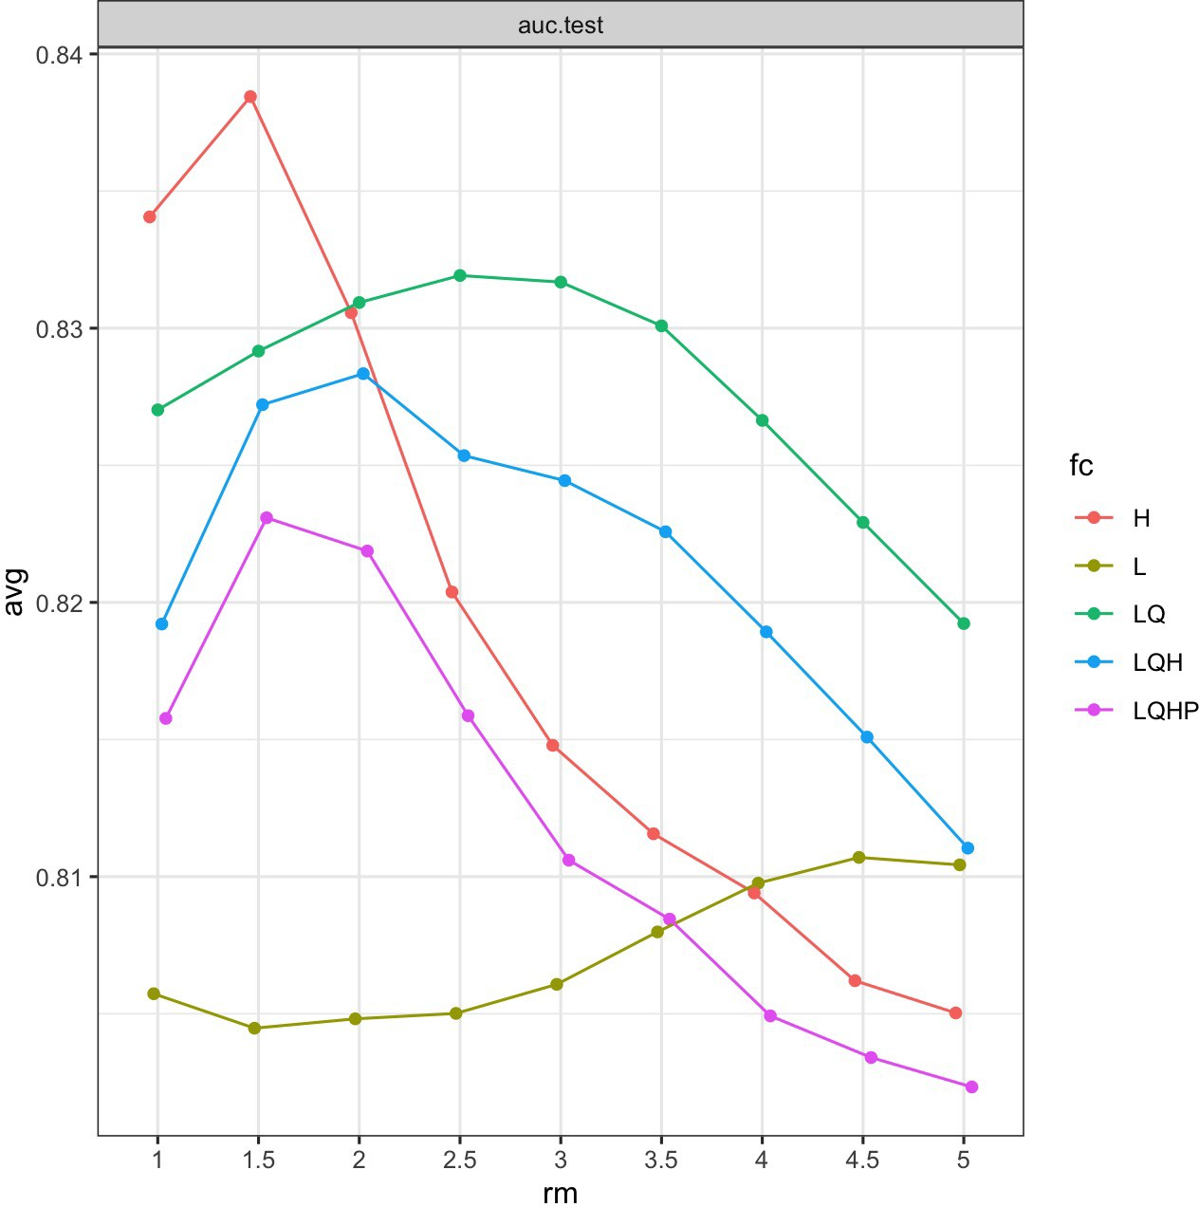
Cross validation
5. Take summary statistics (mean, sd, etc.) on the subset evaluations
Finally, compare the model evaluations to determine the parameter settings for optimal complexity

Slide 20
Model tuning
we can implement cross validation on a suite of models with varying complexity
each model will have associated performance metrics
we can then conduct model selection to choose an “optimal” model

Slide 21
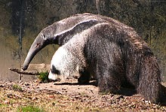
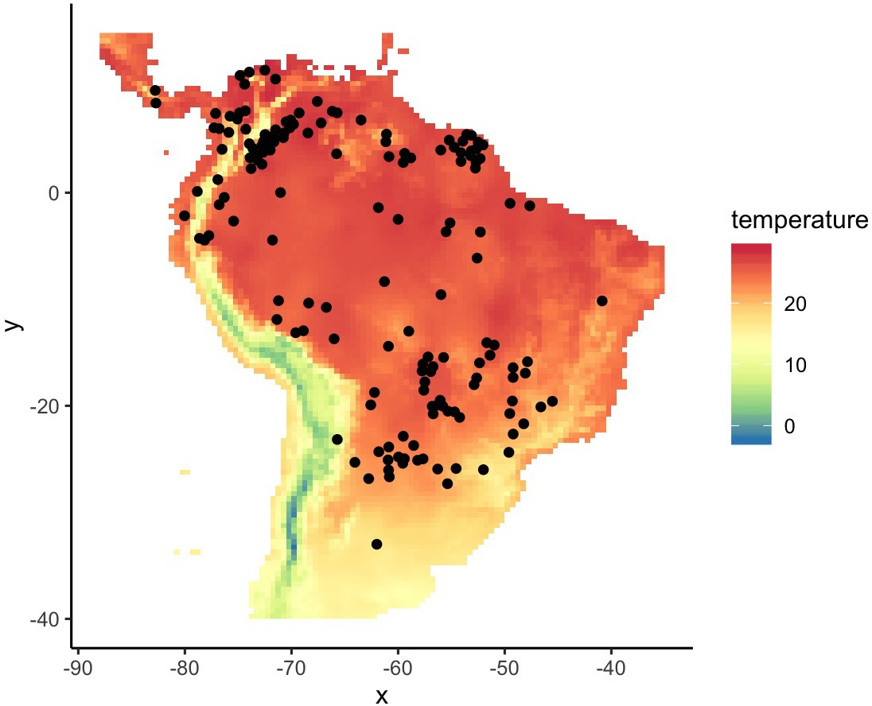
Example: Giant Anteater
downloaded from GBIF with R package spocc
initially, n = 400
after processing (geographic and spatial filtering), n = 155
Myrmecophaga tridactyla

Slide 22
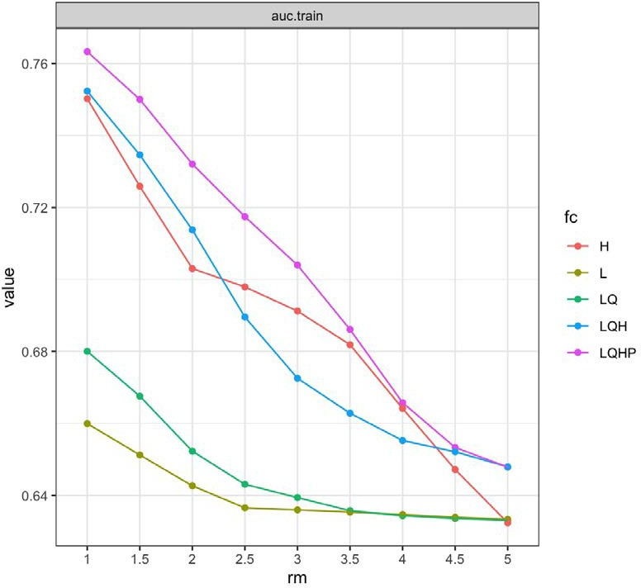
How to evaluate models when tuning?
we could ask how well each model predicts the input data (training data)

Slide 23
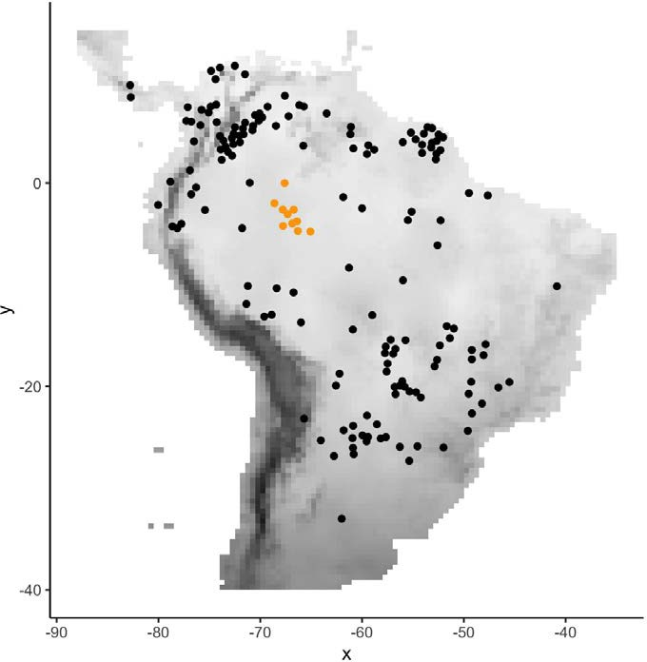
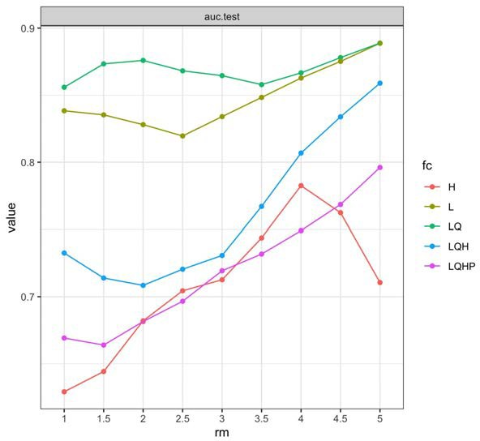
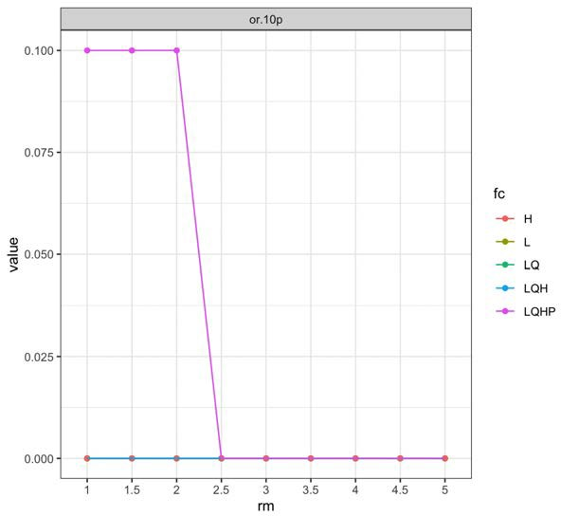
How to evaluate models when tuning?
we could ask how well each model predicts independent data

Slide 24
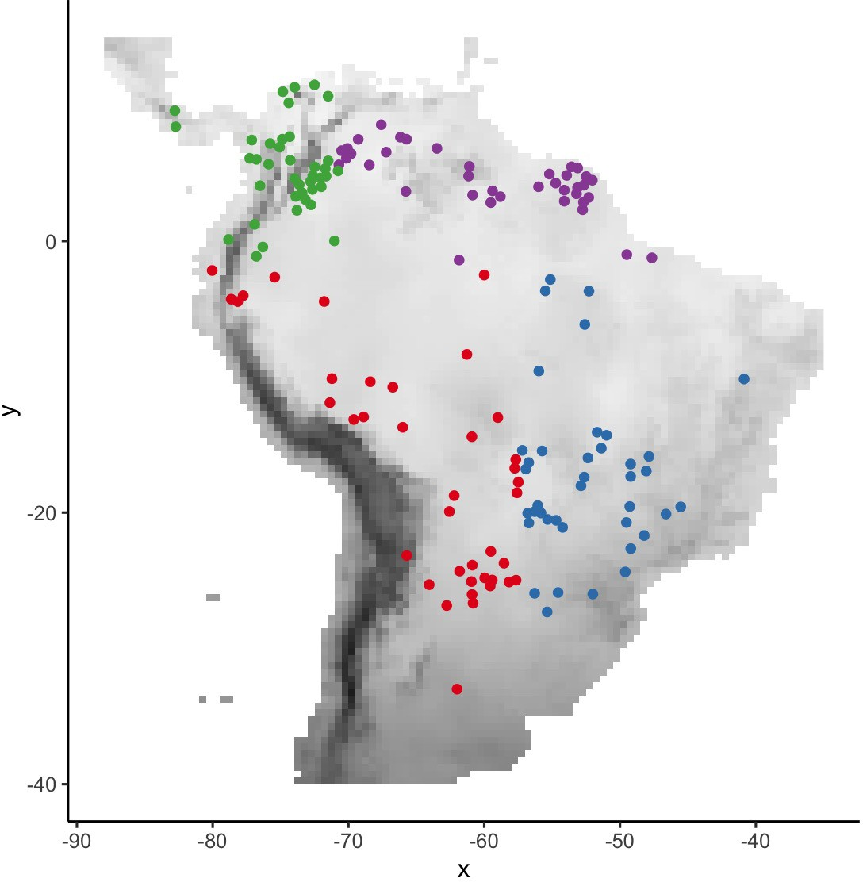
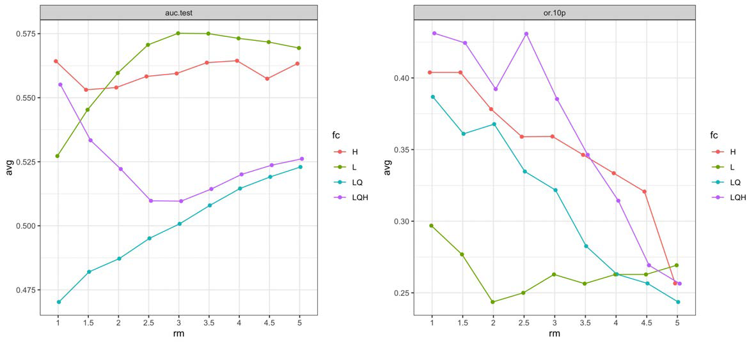
How to evaluate models when tuning?
we could ask how well each model predicts holdout data on average (testing data)

Slide 25
Ideal data subset for cross validation
even number of records across subsets
not always feasible when number of records is low
even sampling across environment
not always feasible when records are absent from certain environments
not desirable when the goal is extrapolation

Slide 26
Purpose of cross validation evaluation
ability to predict the conditions in your data (interpolation)
ability to transfer to new conditions (extrapolation)
need to ask yourself: what do you want your model to do?
then subset your data to make the model evaluations rate this ability

Slide 27
Data for model transfer: terminology
predict
TRAINING DATA
used to fit the model
MODEL
TRANSFER DATA
new time or new place
fit with all data
used to transfer the model

Slide 28
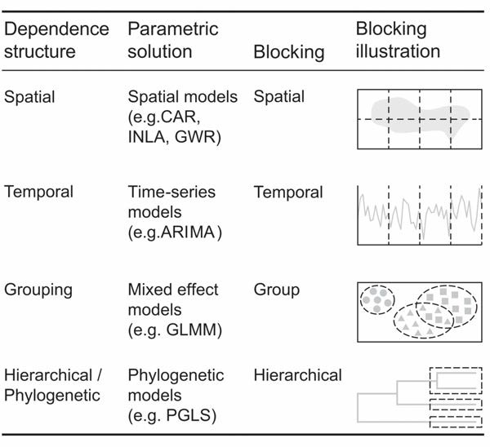
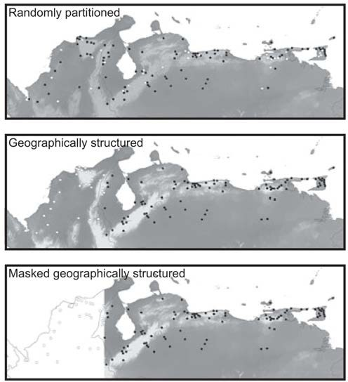
Block vs. non-block subsetting
block subsetting: partitioning the data with some underlying structure
usually results in lower performance than random CV
leads to better evaluations of transferability
with most block subsets, cross validation should include
background data as well
Roberts et al. 2017
Radosavljevic & Anderson 2014

Slide 29
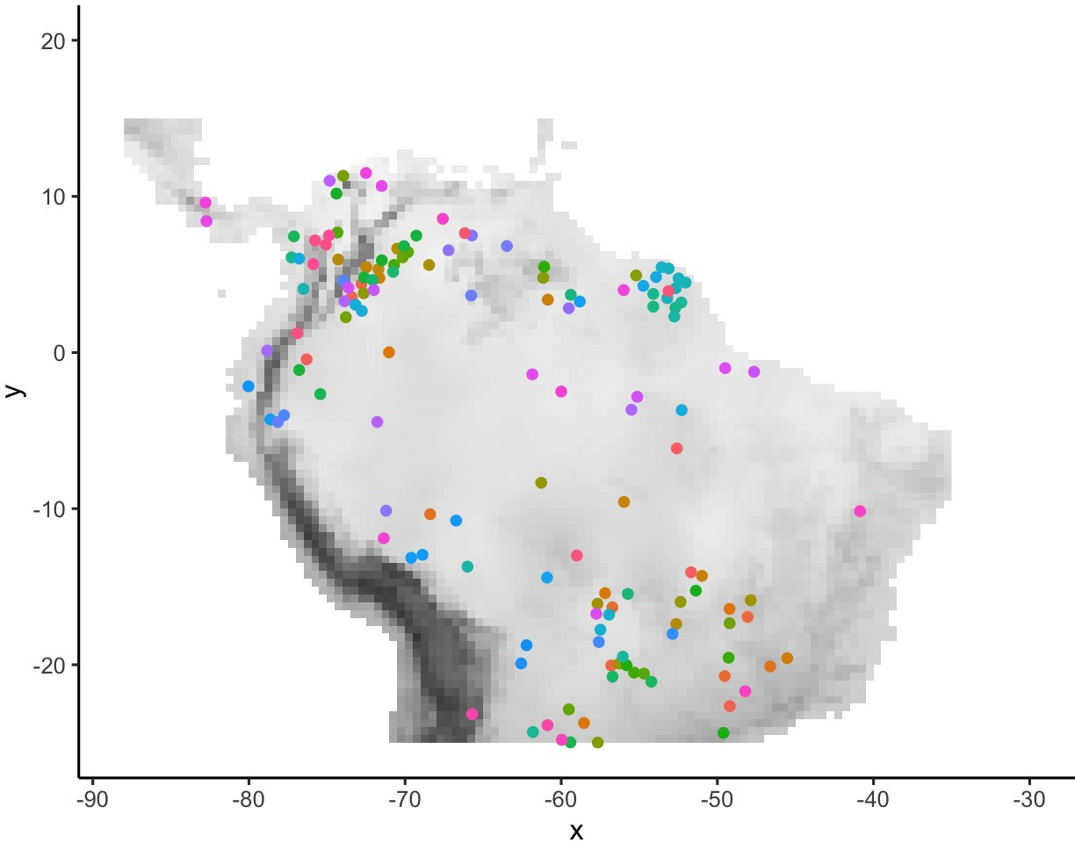
Ways to subset: leave-one-out (jackknife)

Slide 30
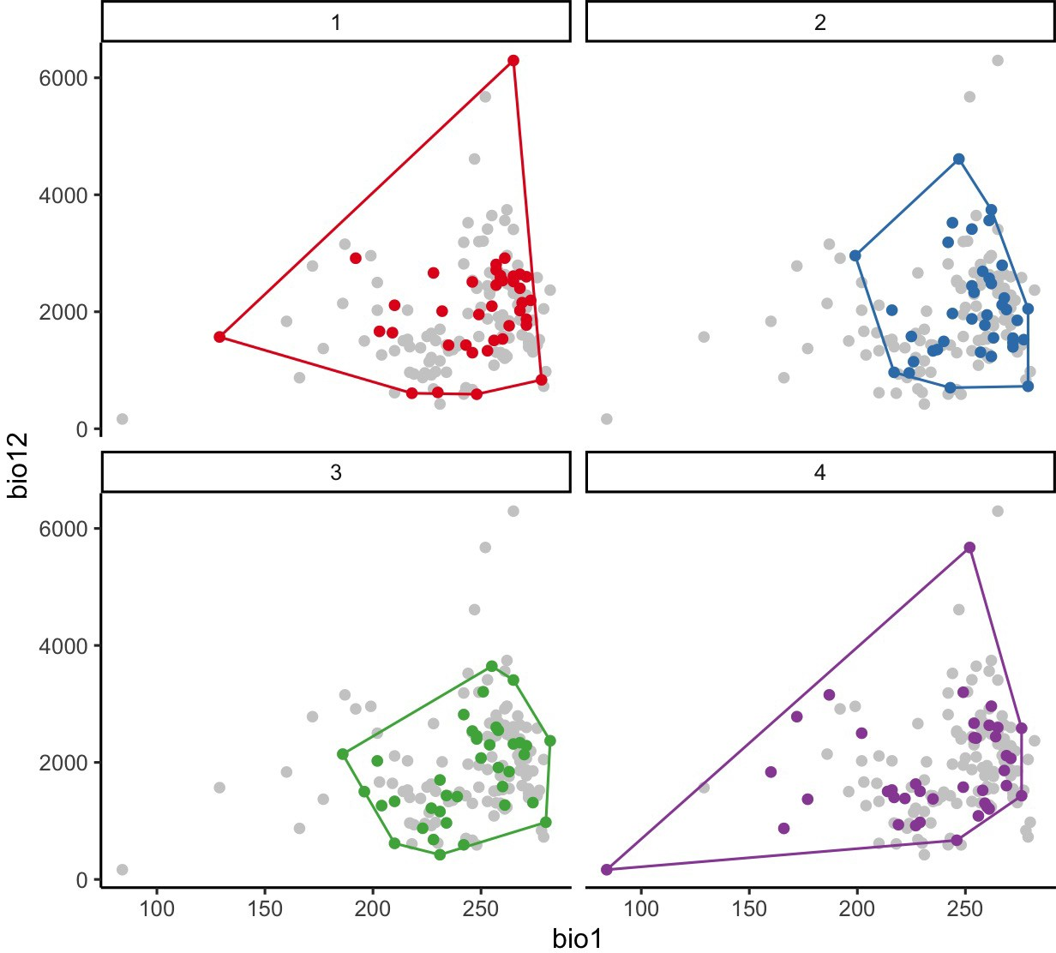
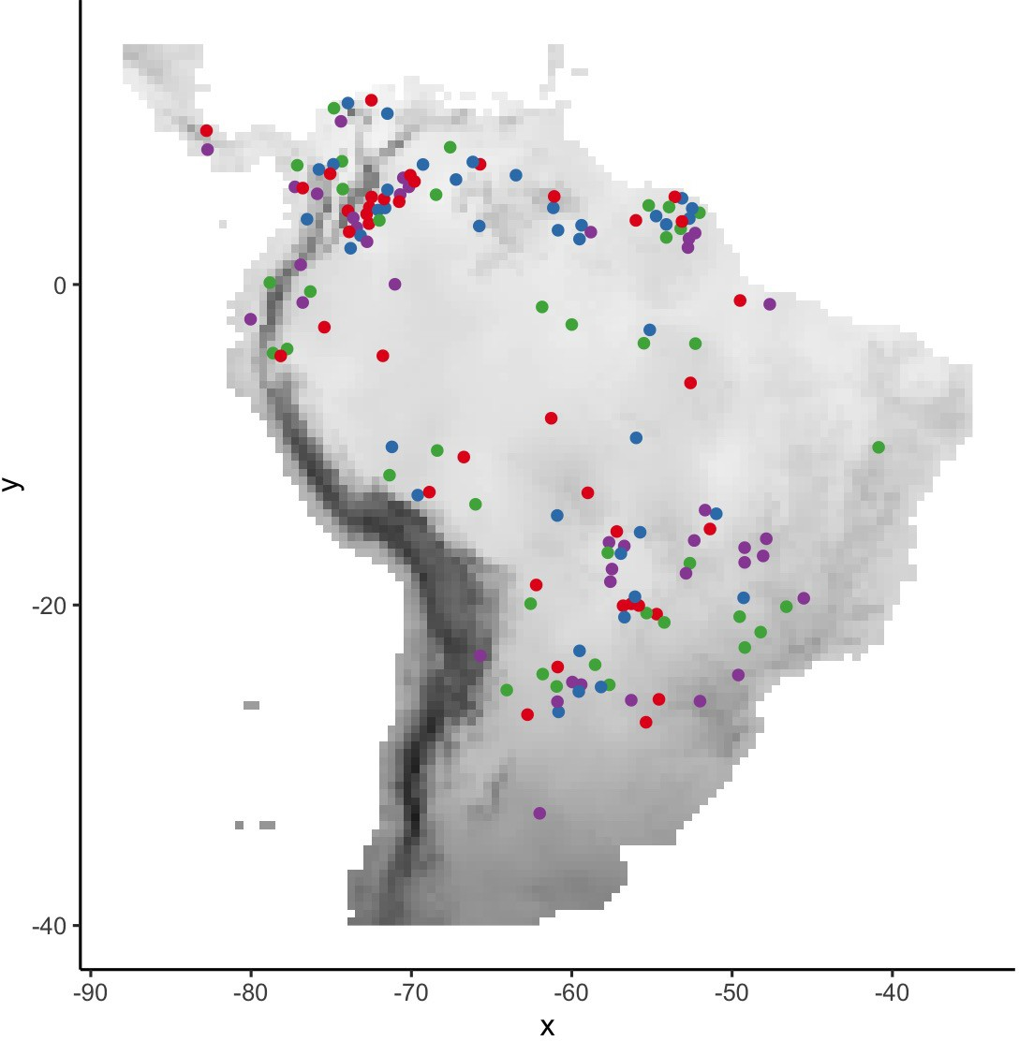
Ways to subset: random
R package ENMeval

Slide 31
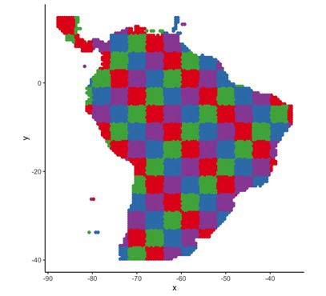
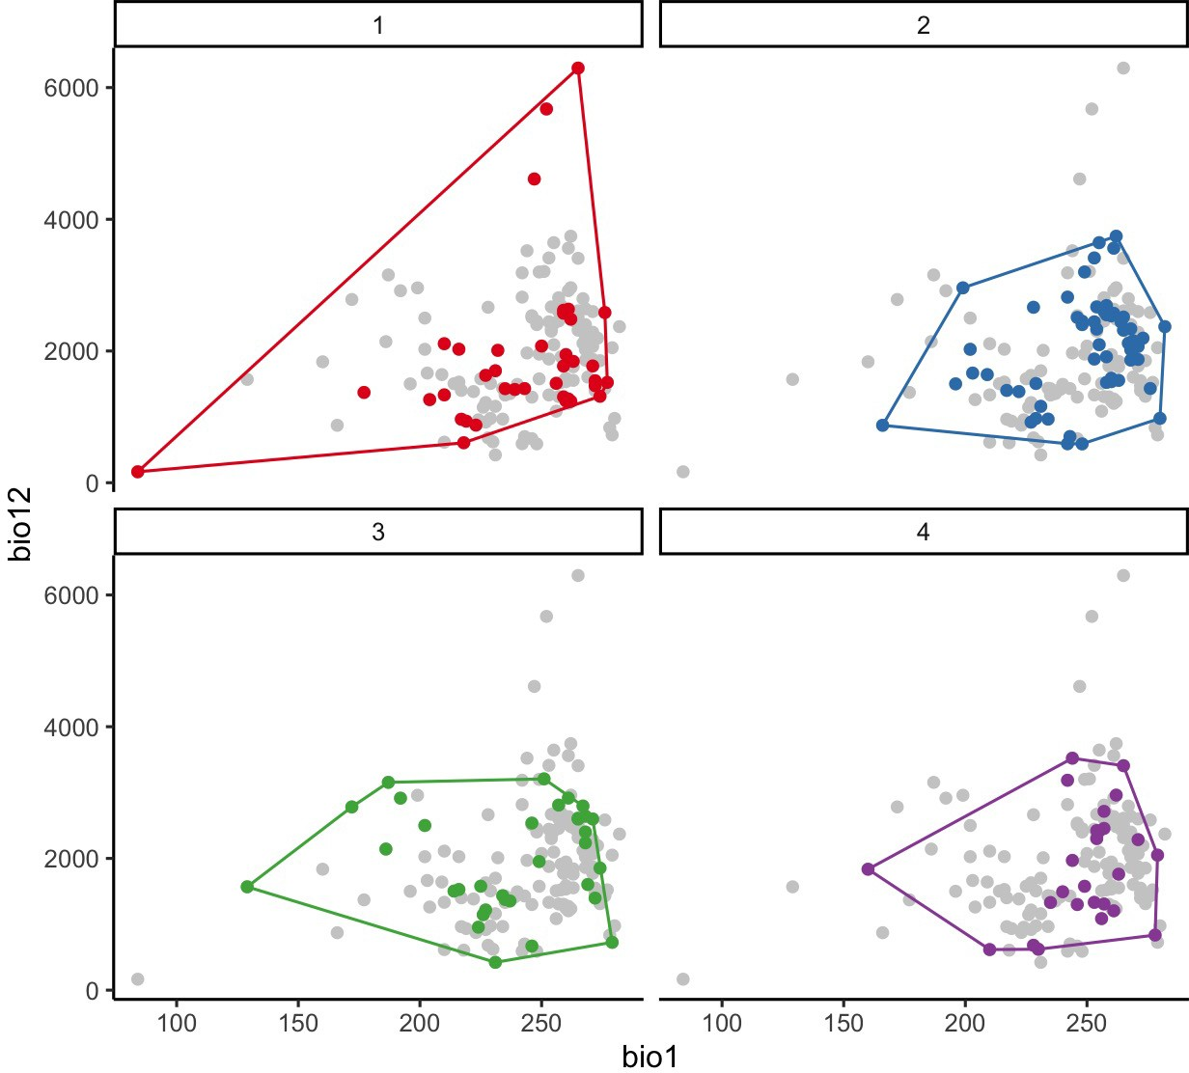
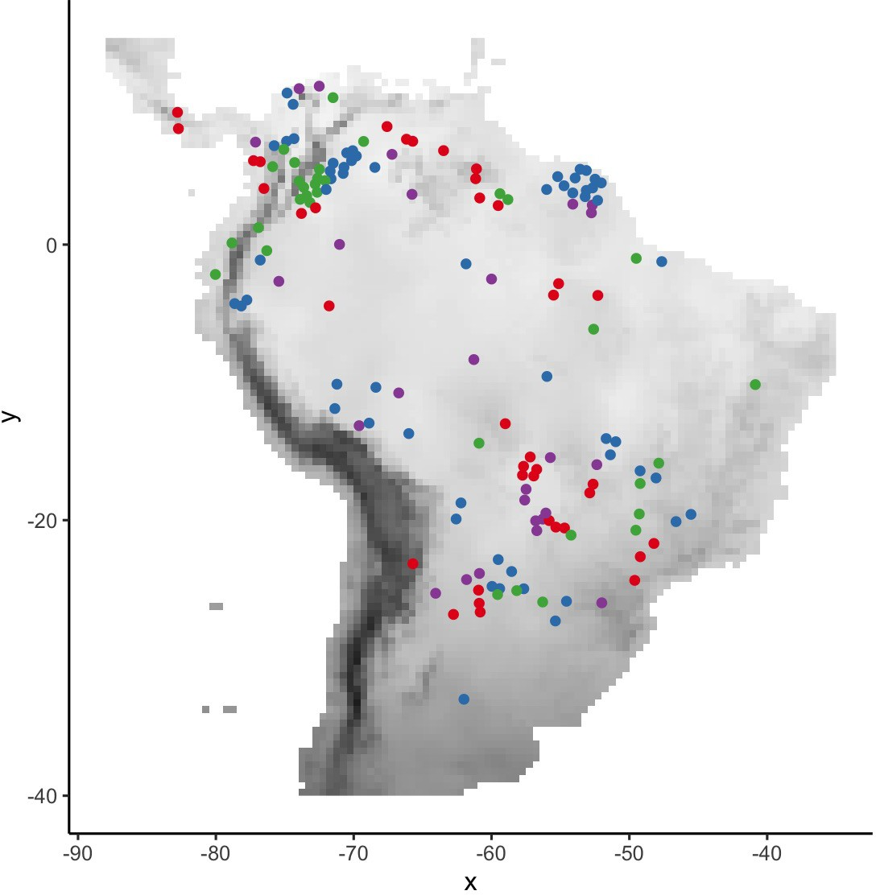
Ways to subset: spatial checkerboard
R package ENMeval

Slide 32
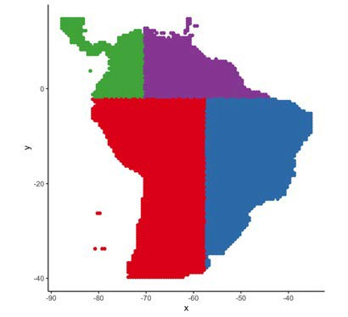
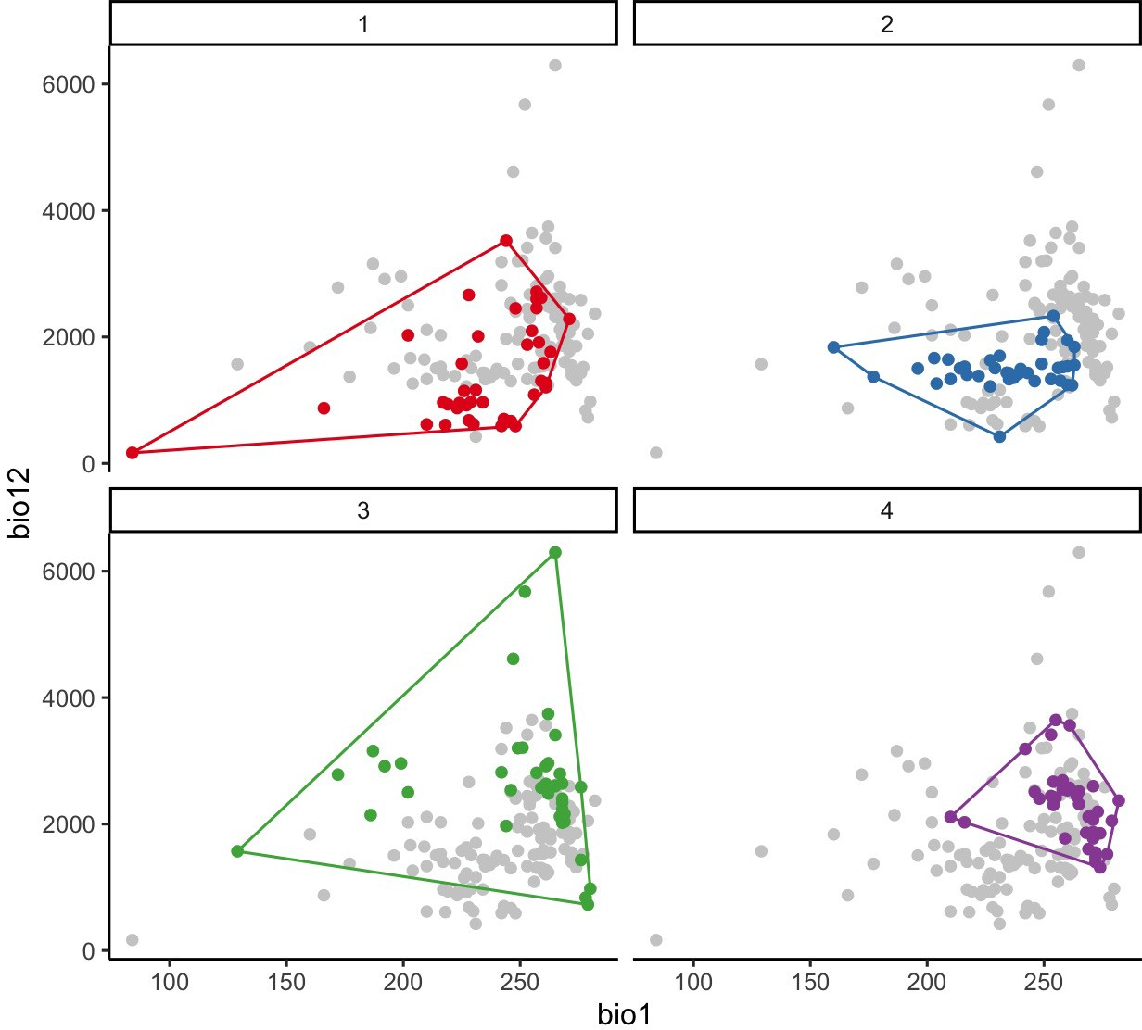
Ways to subset: balanced spatial block
R package ENMeval

Slide 33
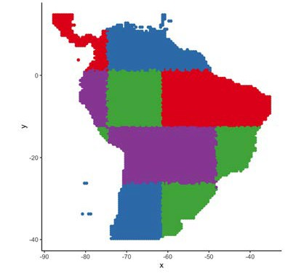
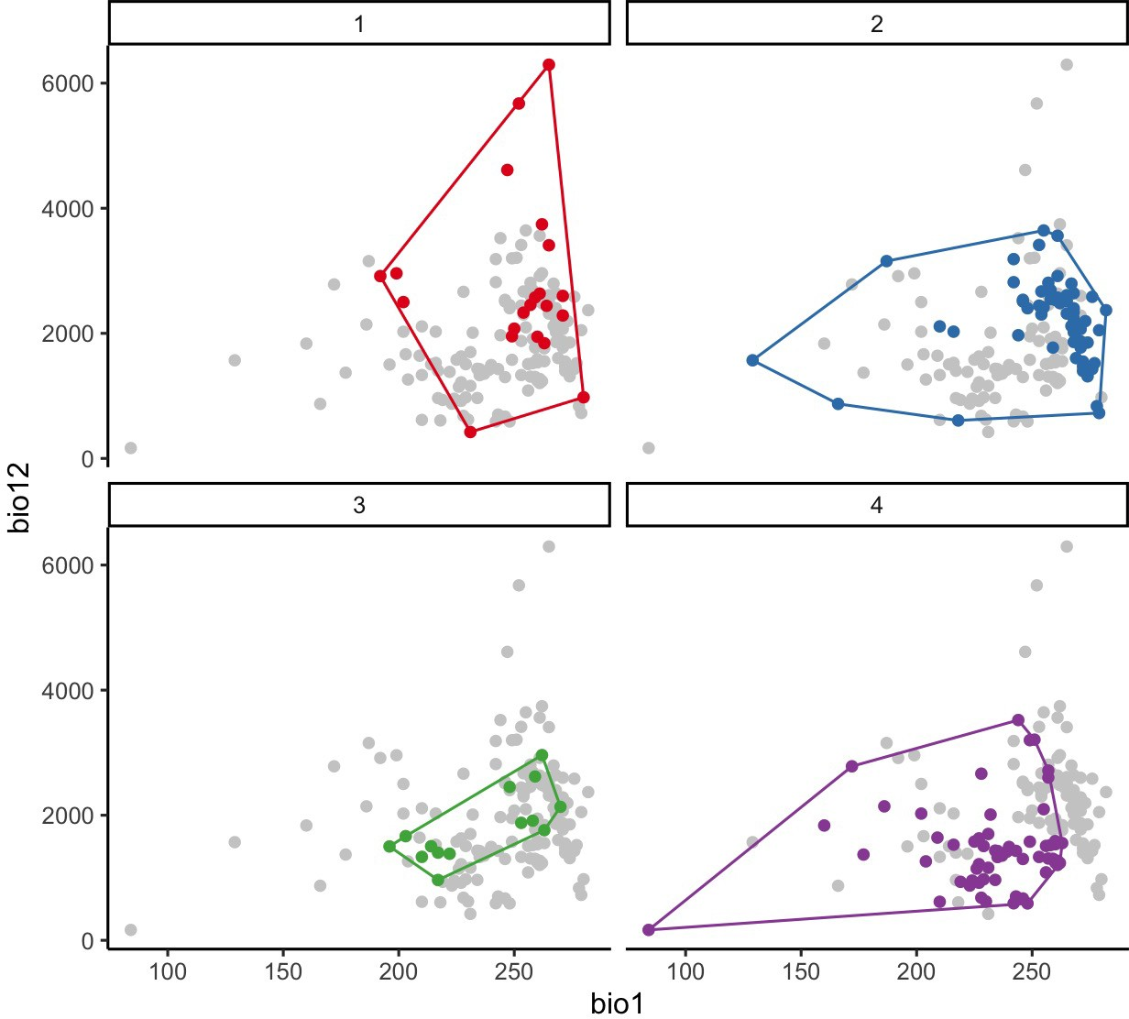
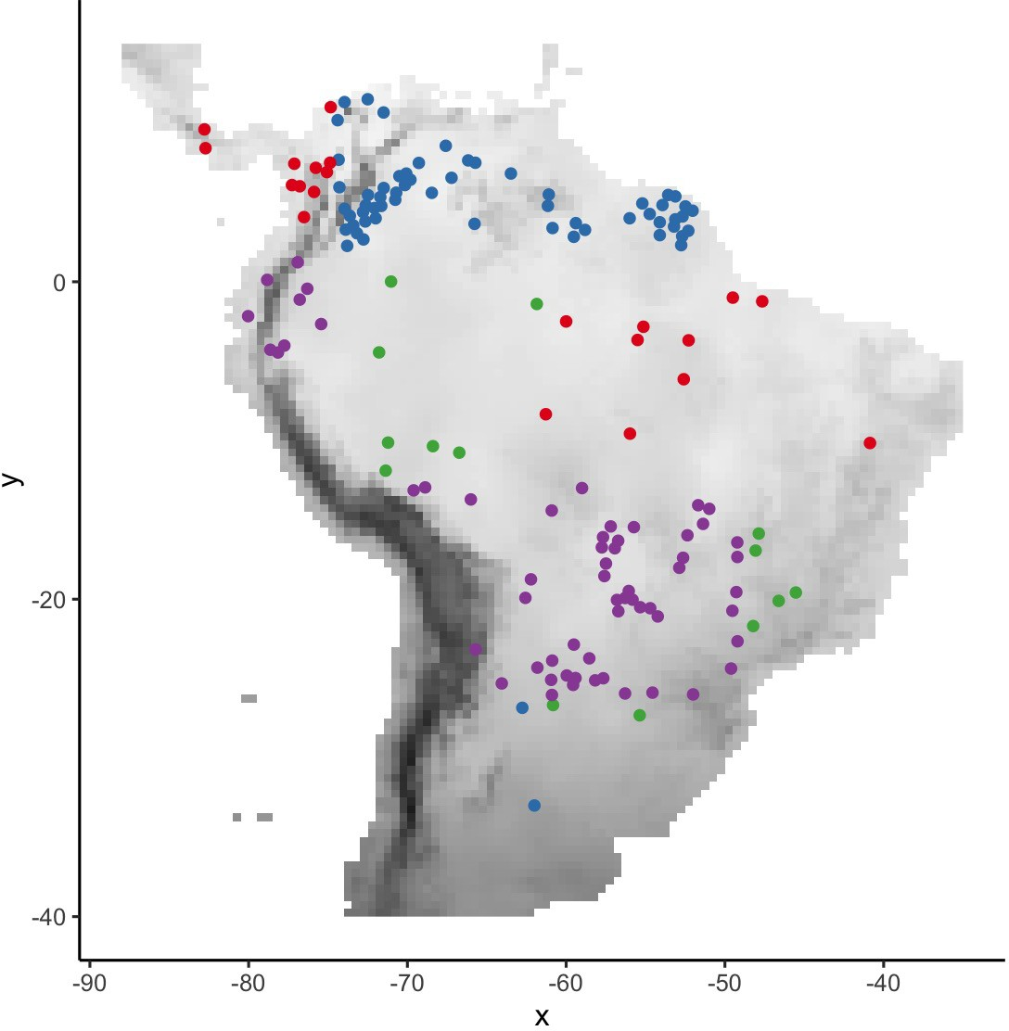
Ways to subset: random spatial blocks
R package blockCV

Slide 34
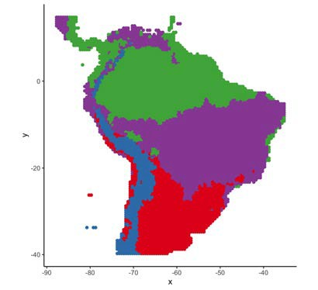
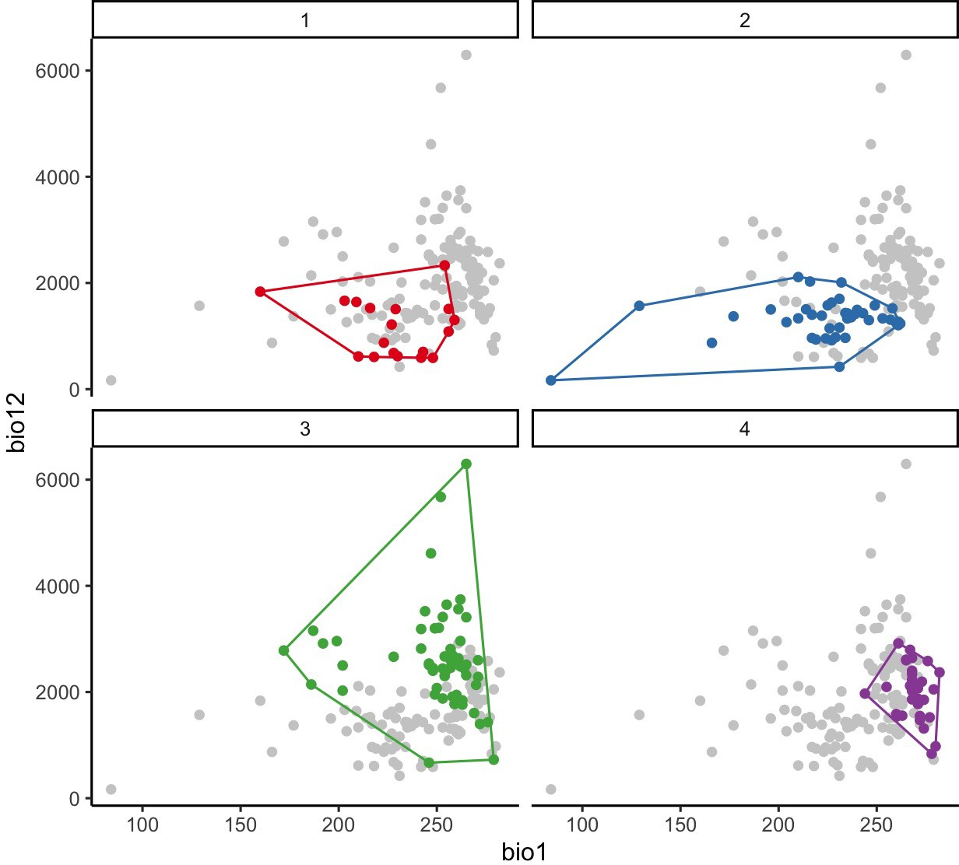
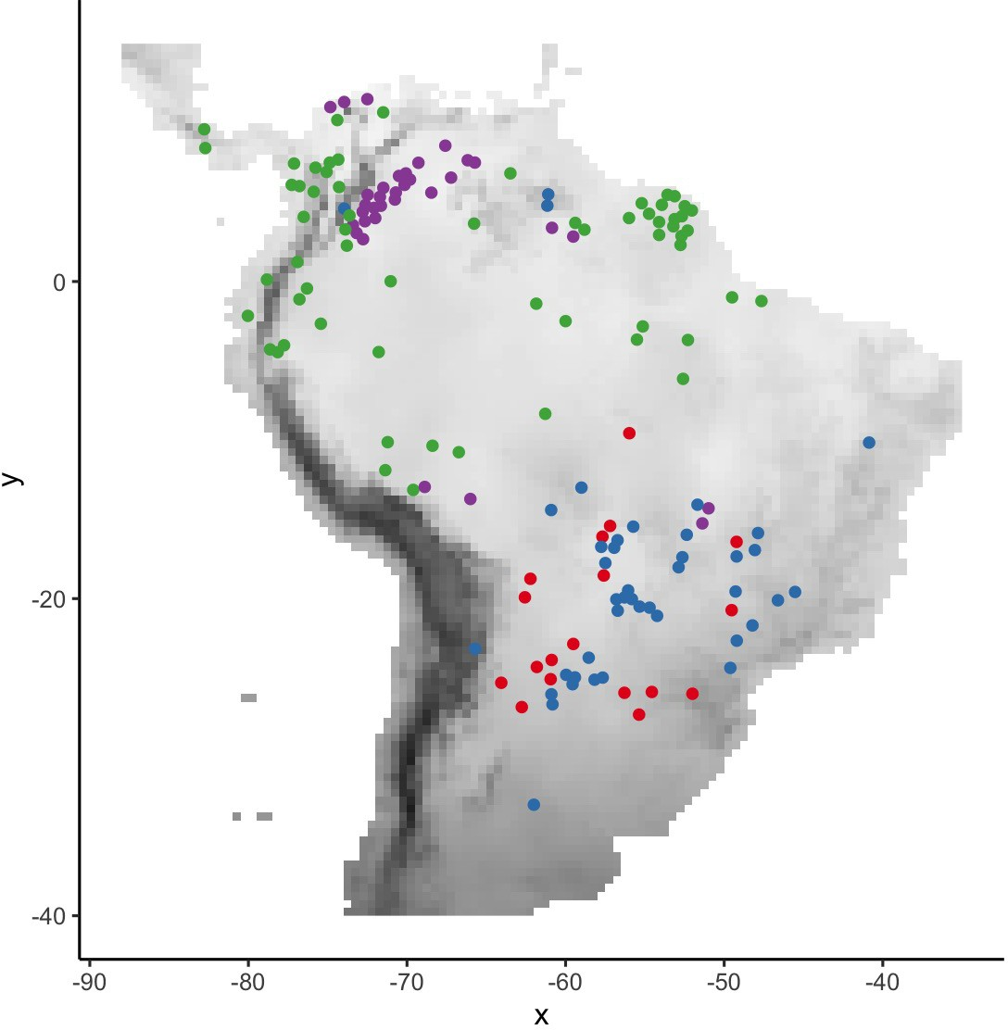
R package blockCV
Ways to subset: environmental blocks
occurrence + background
occurrence only

Slide 35
Random
Block
Checkerboard

Slide 36
Comments on subsetting techniques
leave-one-out (jackknife) best for low-data species
block subsetting should extend to background data
block subsetting usually results in less optimistic evaluation (i.e., more realistic)
spatial checkerboard is likely to have more even sampling across environments than random
some techniques do not ensure even sampling of occurrences
blocking can force model extrapolation

Slide 37
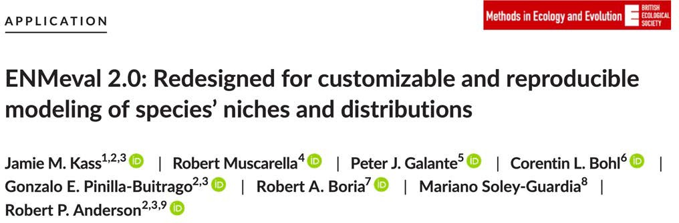
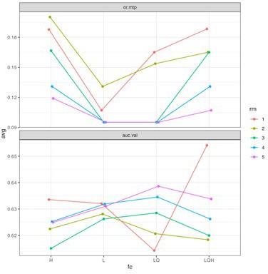
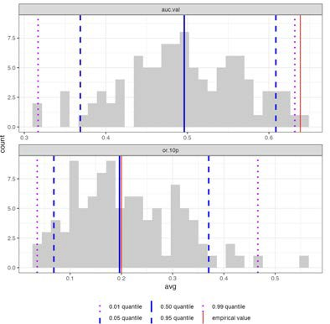
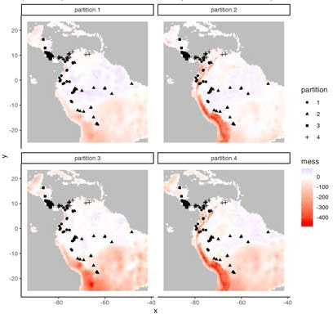
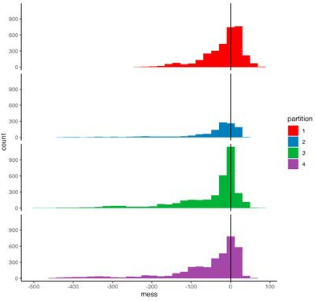
ENMeval 2.0.0
new structure for adding other algorithms
customizable model settings and performance metrics
metadata generation (rangeModelMetadata)
null models to quantify significance and effect sizes
new visualization tools (ggplot2) for mapping partitions and showing environmental differences between them

Slide 38
Conclusions
cross validation can help provide estimates of model evaluation with “independent” data
many ways to subset data (check out ENMeval^{1,2} and blockCV³)
block subsetting has several advantages to random, and becomes very important when models are transferred⁴
choose subsets based on analysis goals (interpolation or extrapolation)
Muscarella et al. 2014
Kass et al. 2021
Valavi et al. 2018
Roberts et al. 2017

